Slide 1
Employee Data Analysis using Excel
STUDENT Name : M.ABINAYA
REGISTER NO : 312216359 & asunm1621312216359
Department : b.com computer application
College : shri shankarlal sundarbai shasun jain college for women

Slide 2
PROJECT TITLE
Employee performance & status analysis using excel

Slide 3
AGENDA
Problem Statement
Project Overview
End Users
Our Solution and Proposition
Dataset Description
Modelling Approach
Results and Discussion
Conclusion

Slide 4
PROBLEM STATEMENT
Need to know the performance of employees in an organization.
How left out & current employees performing.
Number of employees in organization.
How employees have performed based on types (Full Time, Part time & Contract)

Slide 5
PROJECT OVERVIEW
We have found the various rating scale of performance of an employee from 1 – 5 scale, it would be helpful at the yearly performance review to define the hike pay scale.
Provided the numbers of employees left the organization, yet to hire & currently working to find out the numbers of seating availability needed, number of additional assets required.
To inform the employees about loss of pay for absent for long time.

Slide 6
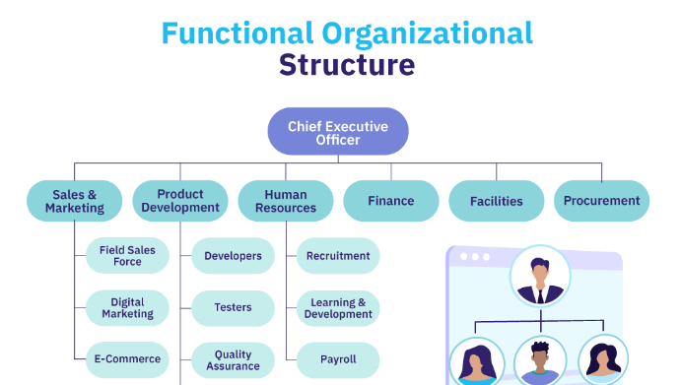
WHO ARE THE END USERS?

Slide 7
OUR SOLUTION AND ITS VALUE PROPOSITION
Conditional formatting- To find out employee’s currently in organization/ employees left.
Formula- employee performance rating scale’& status of an employee
Pivot-employee summary
Graph – Data Visualization of employees in organization

Slide 8

Dataset Description
Employee ID with exit date workings
Performance rating based on current employee rating – Overachieved, .achieved, under achieved & meet expectations
Type of employee - Left, yet to hire, currently working, absent.
Gender – Male/ Female
Number of employee in each business unit

Slide 9

THE "WOW" IN OUR SOLUTION
Performance level =IFS($M2>=5,"OverAchieved",$M2>=4,"Achieved",$M2>=3,"Meet Expectation",TRUE,"Under Achieved")
Type = VLOOKUP([@EmployeeStatus],Sheet3!$A:$B,2,0)
Slicer options using various fields in charts.

Slide 10
MODELLING
Data Collections
Downloaded the data set.
Using Conditional formatting updated the exit date columns.
Data Cleaning:
Update the required data set of columns in another new sheet.
Data Visualization:
Using excel formulas updated the needed fields.
Created an pivot table with slicer options to optimize the results of organization.
Performance analysis by gender, type & also status of employee.

Slide 11
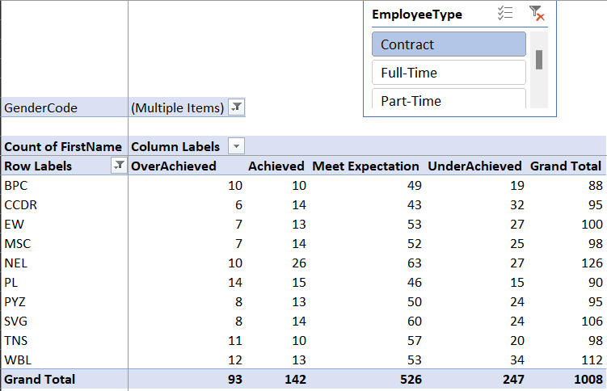
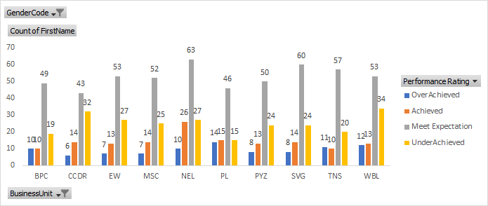
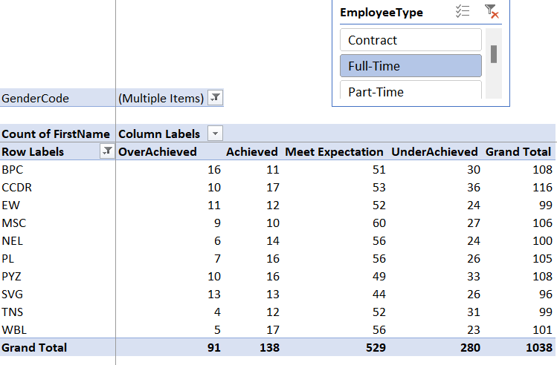
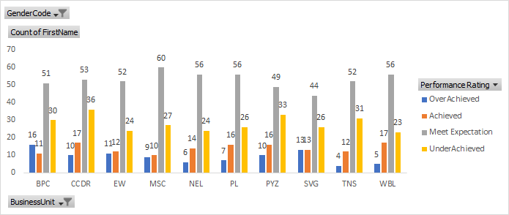
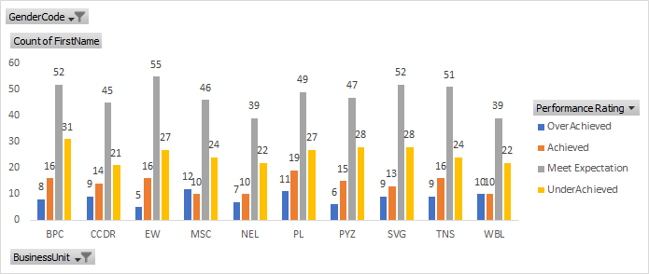
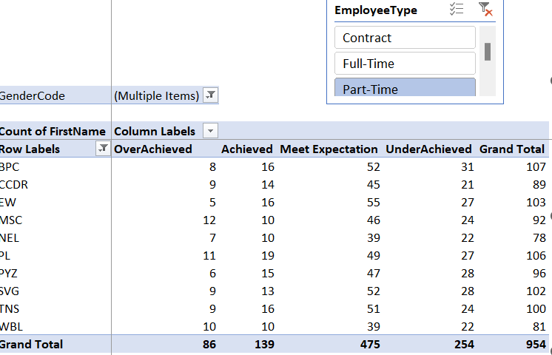
RESULTS
Employees currently working – Contract
Employees currently working – Full Time
Employees currently working – Part Time

Slide 12
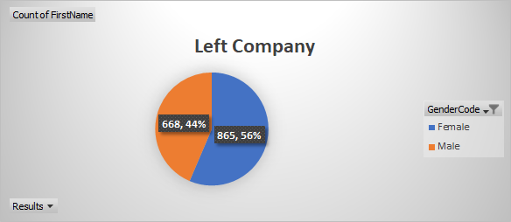
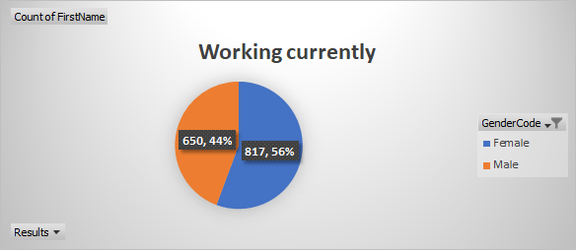
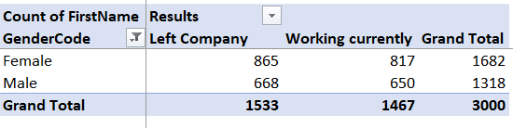
RESULTS

Slide 13
CONCLUSION
Pivot table slicer shows organization performance rating scale based on business units.
Gender type representation of currently working & left company.
Employee type charts of Full Time, Part Time & Contract.

Slide 14
THANKING YOU

